Slide 1
Supporting Our Children
Autism Spectrum Disorder
Parent Workshop - Cycle 1

Slide 2
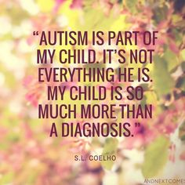
Supporting Our Children
By the end of today’s session, it is hoped you will feel more confident in:
Facts about autism
Literal thinking and processing
Use of language
Supporting distressed behaviour
Establishing positive routine and structure

Slide 3
Supporting our Children
Some Facts about Autism

Slide 4
Supporting our Pupils
A very brief overview
Please refer to the Autism Toolbox which has recently been relaunched for further information: http://www.autismtoolbox.co.uk/home. You will find a range of useful resources here.
Autism, or autism spectrum disorder (ASD), refers to a broad range of conditions characterised by challenges with social skills, repetitive behaviours, speech and nonverbal communication.
It is estimated that autism affects 1 in 50.
We know that there is not one autism but many subtypes. As autism is a spectrum disorder, each person with autism has a distinct set of strengths and differences.
Autism differences are often accompanied by sensory sensitivities and medical issues such as toileting, seizures or sleep disorders as well as anxiety, depression and attention issues.
Autism usually appears by age 2 or 3. Research shows that early intervention leads to positive outcomes later in life for people with autism.

Slide 5
Supporting our Children
What is ASD
Autism is a lifelong developmental disability that affects how people perceive the world and interact with others.
Autistic people see, hear and feel the world differently to other people. If you are autistic, you are autistic for life; autism is not an illness or disease and cannot be cured.
Autism is a spectrum condition

Slide 6
Supporting our Children
ASD Overview
To play this video which is embedded in this slide, you need to make sure you are viewing the presentation as a slide show, which you will find as a tab option at the top if you are not already doing so. The link is below if this does not work.
https://youtu.be/Ezv85LMFx2E

Slide 7
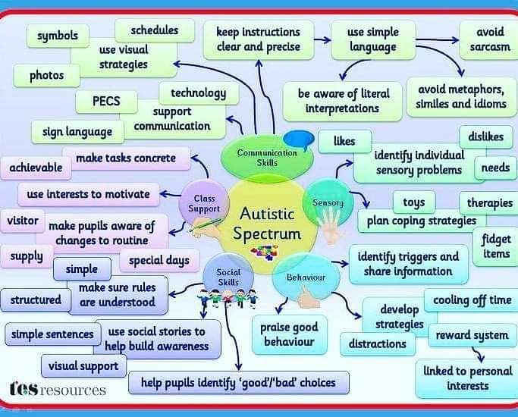
Supporting our Children
ASD Overview
This summary is a useful overview with some helpful references when considering all areas of ASD needs.

Slide 8
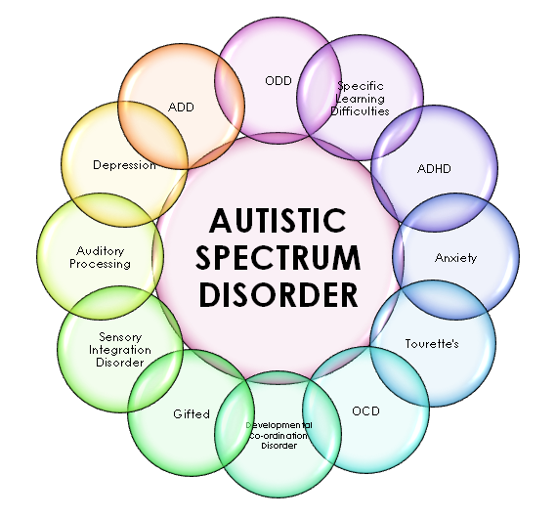
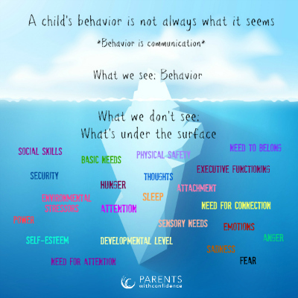
Supporting our Children

Slide 9
Supporting our Children
Parent Perspective
To play this video which is embedded in this slide, you need to make sure you are viewing the presentation as a slide show, which you will find as a tab option at the top if you are not already doing so. The link is below if this does not work.
https://youtu.be/Az2RgDLsnKI

Slide 10
Supporting our Children
Literal Thinking and Processing

Slide 11
Supporting our Children
‘The literal Thinkers’
Autistic people may have difficulties with interpreting both verbal and non-verbal language like gestures or tone of voice. Many may have a very literal understanding of language and think people always mean exactly what they say.
Look at the next 2 slides. There are 8 idioms that we use in our every day language, many of which can be misinterpreted. (Number 5 is not an idiom but a literal phrase and has been included to show how a child with autism may visualise such statements in his or her head).

Slide 12
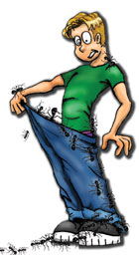
Supporting our Children
1
4
2
3

Slide 13
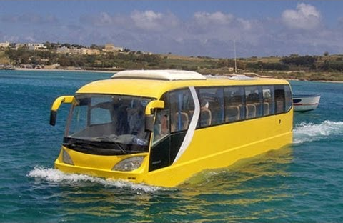
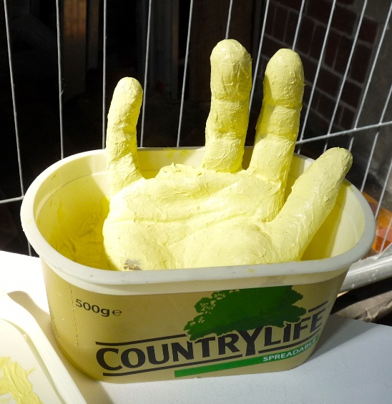
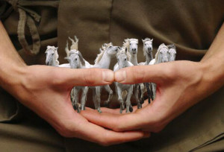
Supporting our Children
5
7
8
6

Slide 14
Supporting our Children
The world we live in can be very confusing for children that interpret things literally. We would be doing them no favours if we did not include indirect language such as idioms in our day to day use. However, if we do, we must be prepared to qualify each, explaining the literal meaning behind what we are saying.
For most of our children, they will understand when we say ‘look at the mess of the place’ to mean that it is time to tidy up. For our children with autism, you may find they simply agree with you and continue with whatever they were doing, so always look to back up and confusion with a literal reinforcer.
Answers:
1) 2 peas in a pod 2) Ants in your pants 3) raining cats and dogs 4) keep your eyes peeled
6) hold your horses 7) butter fingers 8) weight of the world on your shoulders
5) Going swimming on the bus – the inference being the children will travel to the pool on the bus but the child with autism may interpret this that they are actually swimming on the bus.

Slide 15
Supporting our Children
Use of Language

Slide 16
Supporting our Children
Now
Please be aware that the words we use, the tone we pitch our voice and the way we say things are more often than not the main triggers for children. Focusing on our use of language, especially if there is a particular child in your class that regularly experiences distressed behaviour can go a long way to preventing situations from escalating
Next
Look at the next slide and see if you can identify a softer alternative to each of the statements on the next page. Consider how you can introduce this more supportive approach into your own practice. Reflect where you may have inadvertently escalated a situation through the words you have used when engaging with a distressed child. What could you have said differently that may have deescalated the situation instead.
Then
Watch the short video clip displaying the impact our language can have. To play the video that is embedded in the slide, you need to be viewing the presentation as a slide show, which you will find as an option at the top if you are not already doing so.

Slide 17
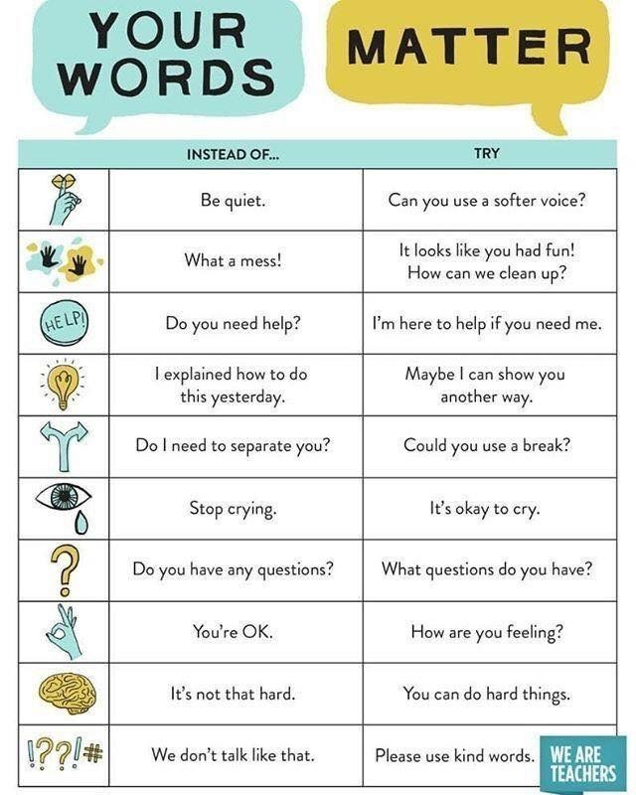
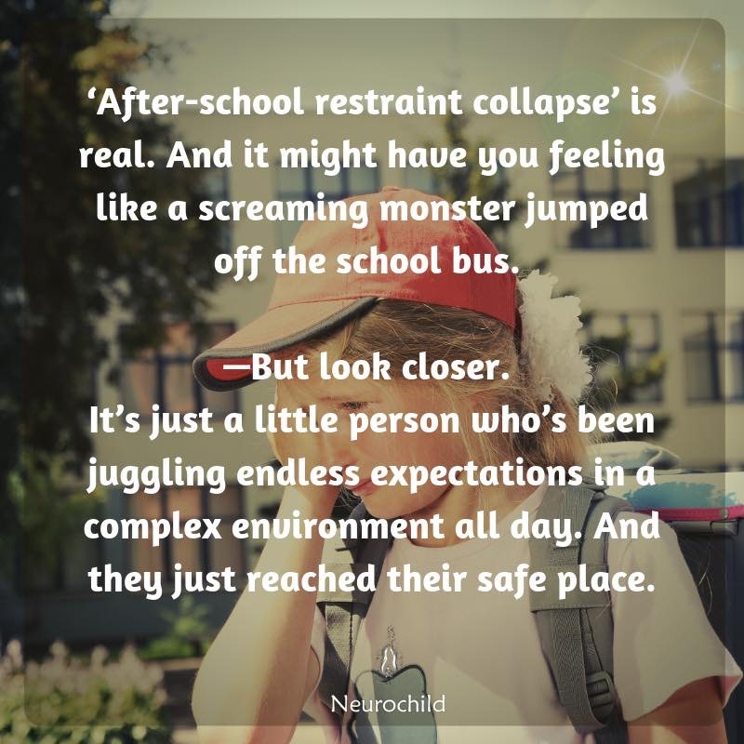
Supporting our Children
Can you come up with some positive alternatives for each of these potentially inflammatory statements?

Slide 18
Supporting our Children
https://youtu.be/zpPz2qBpAaY
To play this video which is embedded in this slide, you need to make sure you are viewing the presentation as a slide show, which you will find as a tab option at the top if you are not already doing so. The link is below if this does not work.

Slide 19
Supporting our Children
Look to engage in stressful situations with a curious mind. It is better to think ‘I wonder what caused this, let me find out’, instead of ‘I am angry that this has happened again, he deserves to be punished’.
If you are responding to a stressful situation from your ‘thinking brain’, you will be able to use statements that are supportive that may deescalate the situation. If you enter a distressed situation using the ‘emotional brain’, your response may be heightened and in turn, further escalate the situation.
Look at the next slide for examples of supportive statements that you could add to your script.

Slide 20
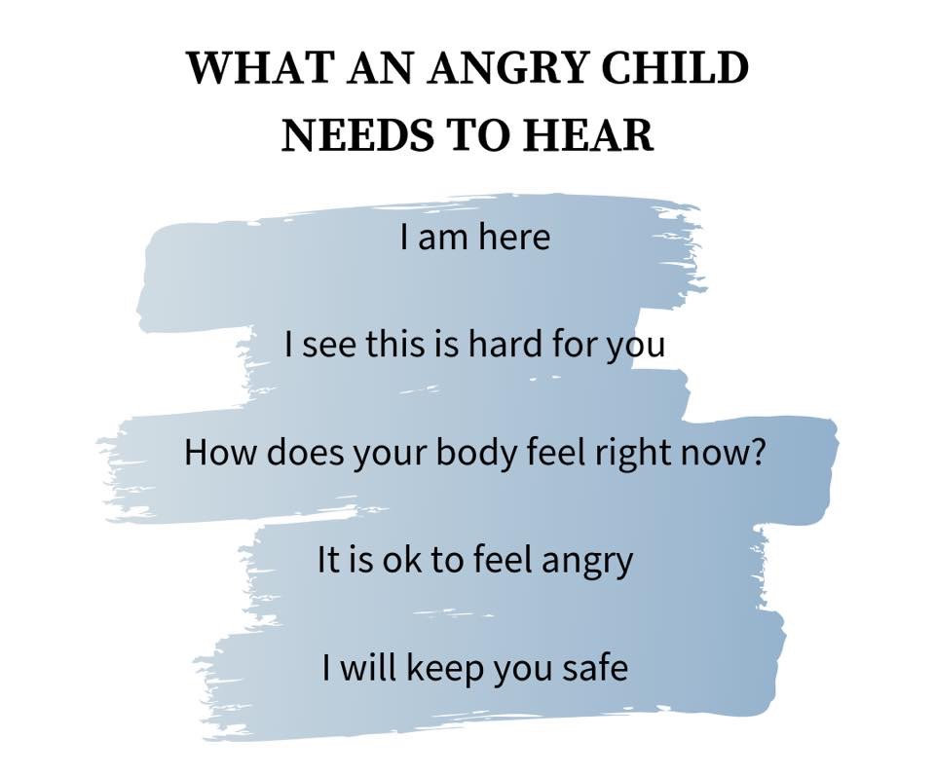
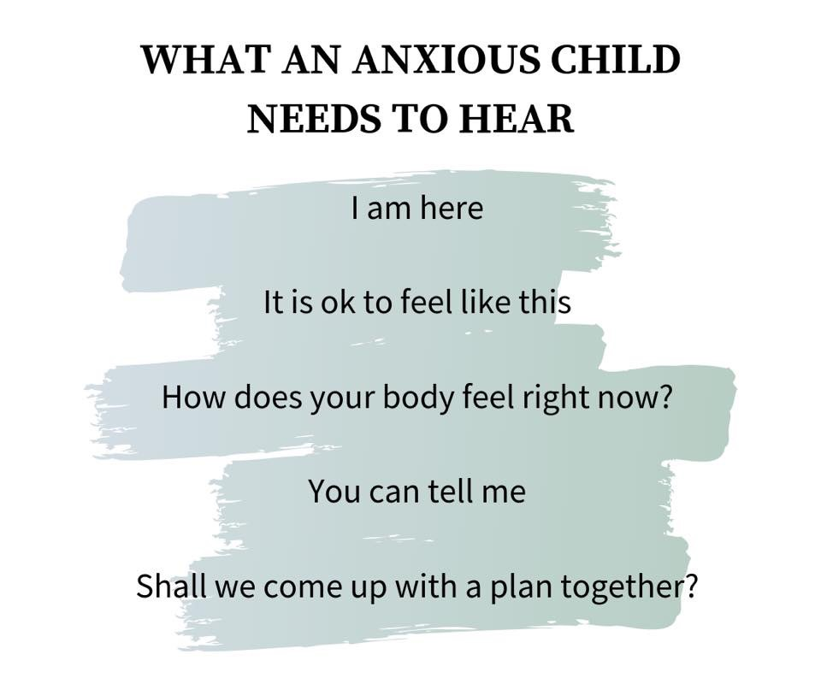
Supporting our Children

Slide 21
Supporting our Children
Supporting Distressed Behaviour

Slide 22
Supporting our Children
Consider aspects that may trigger a distressed response in pupils. If you are able to identify what it might be, you can then work to negate the issue:
Biological Triggers
hunger
thirst
feeling tired
feeling unwell
medication
Environmental Triggers
transitions
too hot / too cold
are the lights flickering
sensory sensitivity
change to the daily routine
Early Warning Sign
becoming agitated
withdrawing from activity
verbal outbursts
facial expressions/body language
behavioural change
physiological signs
Social Triggers
change of personnel
change of dynamics in peer group.
fallen out with friends
consider the use of language; avoid sarcasm.
Psychological Triggers
unfavoured activity approaching
disappointment
fear
frustration
a sense of injustice

Slide 23
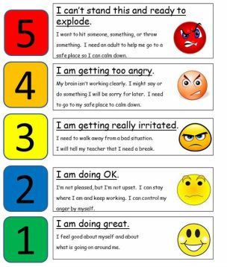
Supporting our Pupils
The Incredible 5 point Scale is a great way to allow children with communication differences to replace language with numbers.
For those that find it difficult to put into words how they are feeling or what triggered a distressed response, they can use this simple 1 to 5 grading system to quickly identify that there is an issue.
If you google ‘5 point scale’ and click on images, you will see various versions of this, many of which have been created using pupil motivators or special interests.
Consider creating a 5 point scale along with your pupils, setting the tone that it is ok to feel distressed, but it is how we respond in these moments of crisis that is important. Using language like ‘John, I can see you are a 4, take some ‘time in’ in the calm corner’ (the term ‘time out’ can sound like a punishment).

Slide 24
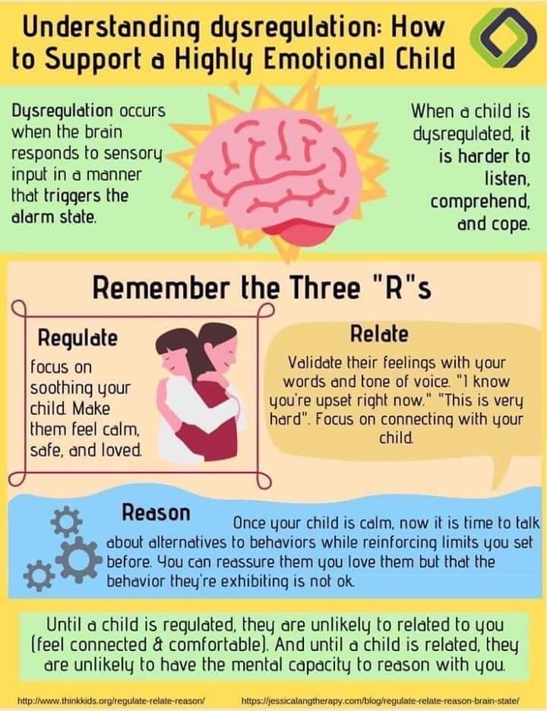
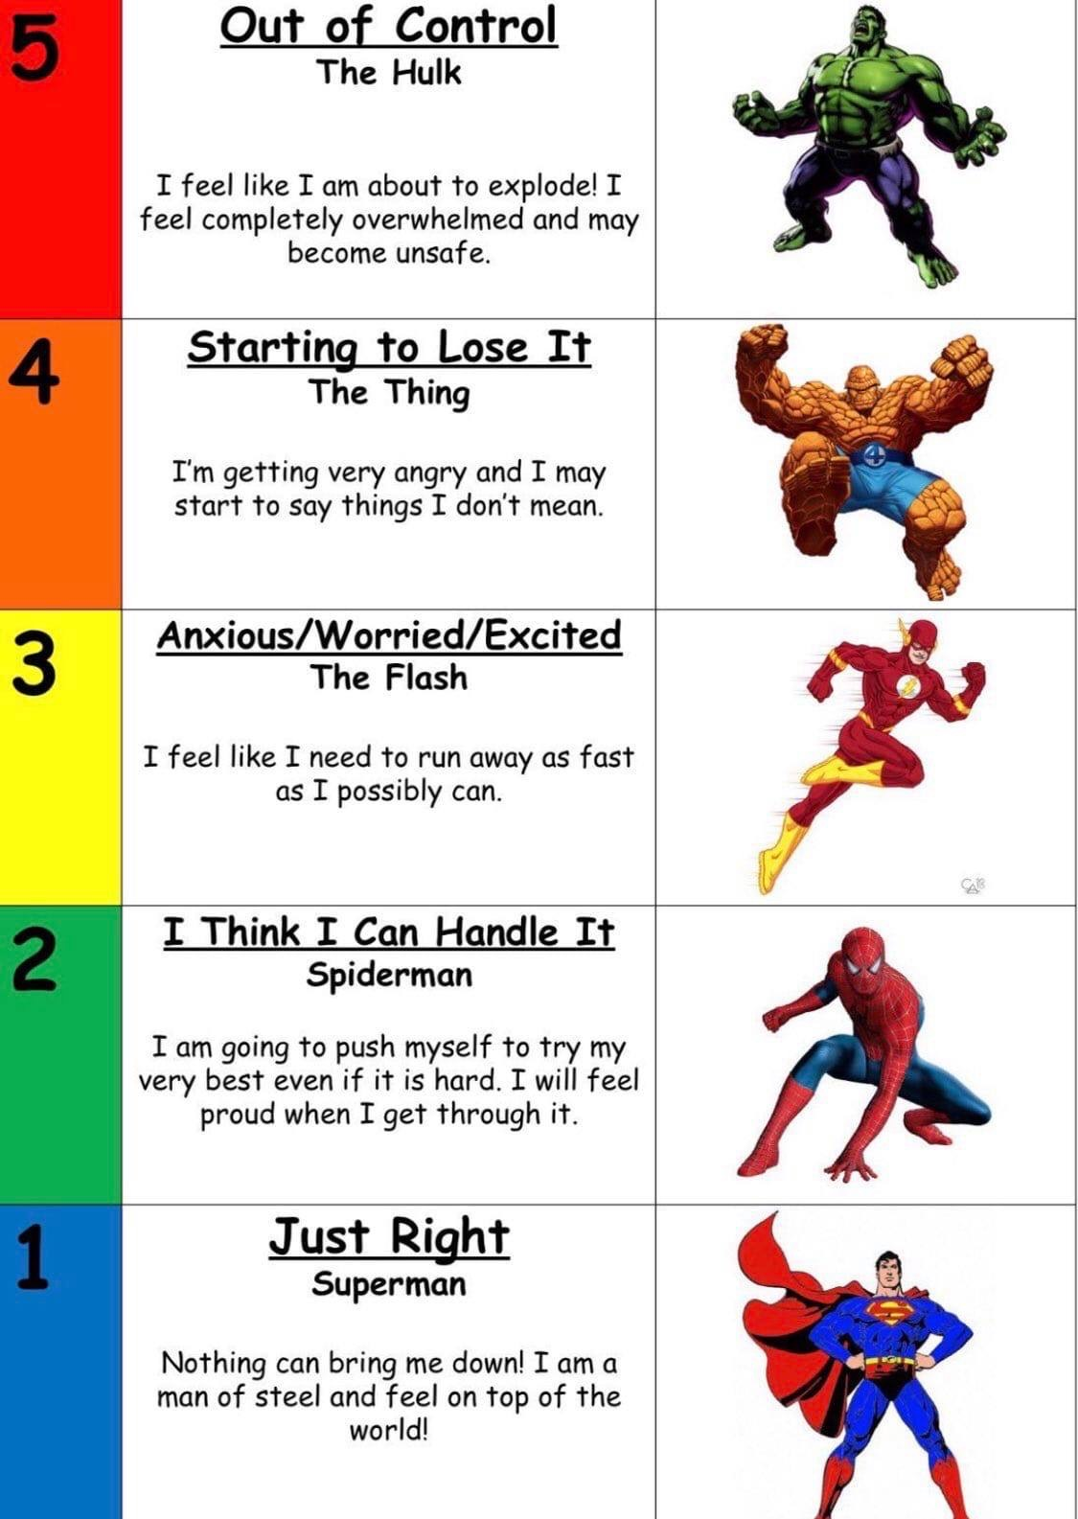
Supporting our Children

Slide 25
Supporting our Children
What Sensory Activities Could you Introduce
Walking/Moving in time with an adult
Calm Box including slime, putty, soft/tough, footer objects
Rocking/Swinging opportunities
Mindfulness activities – breathing, calm music, colouring,
Engage in a motivating activity based on your child’s interests
Hand massage
Introduce these to your child during a positive/calm point of the day

Slide 26
Supporting our Children
Useful contacts and Websites
New Post Diagnostic Support Service – Scottish Autism
https://www.scottishautism.org/services-support/family-support/information-resources/post-diagnosis-support-carers
Different Minds
https://differentminds.scot/get-involved/
National Autistic Society – Renfrewshire Branch
https://www.autism.org.uk/directory/n/nas-renfrewshire-branch
https://www.autismlinks.co.uk/support-groups/group-support-scotland/nasrenfrewshirebranch?region=
Always Included (based in Johnstone)
Facebook – A.I 079 2522 1811
Renfrewshire Carers Centre
https://renfrewshirecarers.org.uk/carer-training/

Slide 27
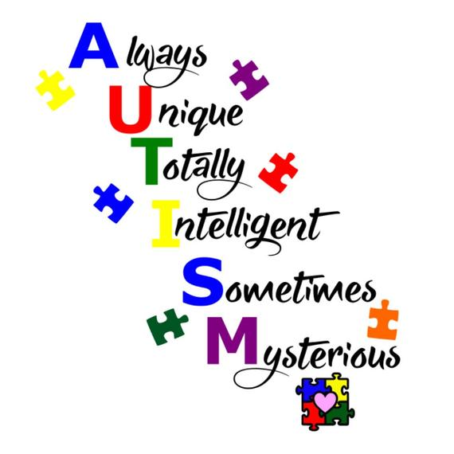
Supporting our Children

