Slide 1



School Lunches at Houston Primary School’s Early Learning & Childcare Class

Slide 2

ALLERGIES AND FOOD INTOLERANCES
Staff should be made aware of any allergies or food intolerances, prior to your child starting at nursery.
Allergies and other relevant information can be stored electronically on the system.
Vegetarian option provided each day.
Provision can be made for special dietary requirements
(e.g. gluten intolerant)

Slide 3
General Lunchtime ROUTINE
Support staff will clean and set up the lunch tables. They will prepare for lunch by collecting and organising meals, utensils etc.
Children will use the toilet and then wash their hands. They will then make their way to the lunch tables at around 12.00 noon or 1.15pm, depending on their attendance pattern.
Staff will sit with the children whilst they eat, engaging the children in conversation and helping them where necessary. Lunchtime will be a calm and sociable experience. Often, staff will play music. Children will be encouraged to develop their self-help skills e.g. cutting up food, inserting straws into drink cartons.
Children can take as long as they wish to eat and provision will be made should a child require longer than the allocated 45 minutes.
Children will have time to relax after lunch e.g. a walk outdoors, a story.

Slide 4

Packed Lunches
Sometimes, children prefer to bring a packed lunch from home. Packed lunch bags should be clearly labelled with your child’s name.
In order to keep lunches as fresh as possible, we would ask that you include a cool pack in your child’s lunch box.
Please be mindful that some children suffer from nut allergies and therefore foods containing nuts should be avoided. We have included some suggestions, if you are looking for some ideas of what to include.
Lunchboxes will be stored in refrigerator.
Some ideas for lunchboxes...
sandwiches, pitta pouch, bagels, breadsticks, crackers, pasta and rice
salads
chopped raw vegetables, fruit
sandwich fillings: ham, turkey, chicken, fish, hummus and egg
small serving of cheese, yogurt, fromage frais, pot of custard or mousse
water, milk or a small carton of fruit juice

Slide 5

ScHOOL AND EL&CC Lunches
All children from nursery to primary 3 are entitled to a free school meal.
It’s worthwhile discussing with your child, in advance, the options available each day, so that they select something they like.
Lunches are ordered using an iPad whereby each child selects their name and then chooses which lunch option they would like. There is usually the option of a sandwich (cheese, ham or tuna) and a hot lunch option. Both come with fruit and a yoghurt. Children may choose to drink water or milk.

Slide 6

SAMPLE Lunch Menu
Sample Menu
Option 1: Sandwich
Option 2: Chicken goujons in a wrap
Dessert:* Yoghurt and piece of fruit
Drinks: Milk or water
Children have the option to include salad.

Slide 7
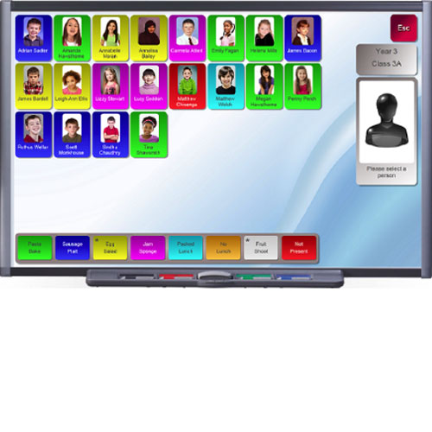
Ordering a lunch FROM THE EL&CC
Completed in nursery at the beginning of your child’s session.
Staff member shares menu options with children
Children help to select own name from the iPad, with the support of an adult
Child selects their preferred lunch option

Slide 8

Tidy Up and Recycling
In order to develop independence children will be
encouraged to:
take their plate to the recycling station
put any food waste in the appropriate bin
put plates in appropriate trays
Place cutlery in the basin.

Slide 9
Encouraging reluctant eaters
Allow your child to help prepare or select items for their lunchbox.
For those children enjoying a packed lunch, any food they do not want to eat will be left in their lunchbox.
Discuss school lunch menu options before nursery to ensure that your child is happy to eat what is on offer.
Stickers might be used to encourage reluctant eaters.
A member of staff will communicate your child’s achievements and any concerns.

